Slide 1
Cloud Computing
The term cloud refers to a network or the internet.
It is a technology that uses remote servers on the internet to store, manage, and access data online rather than on local drives.
The data can be anything such as files, images, documents, audio, video, and more.
There are the following operations that we can do using cloud computing:
Developing new applications and services
Storage, backup, and recovery of data
Hosting blogs and websites
Delivery of software on demand
Analysis of data
Streaming videos and audio

Slide 2
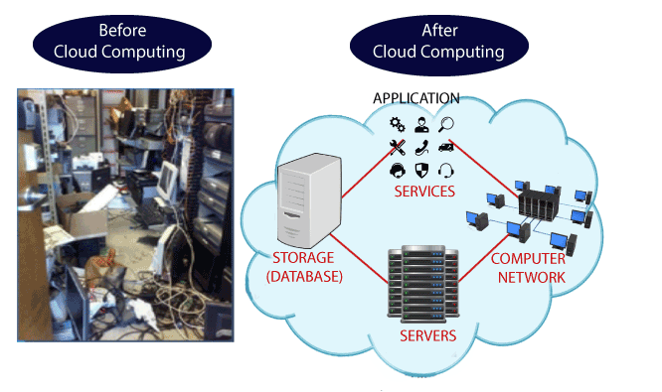
Why Cloud Computing?

Slide 3
Why Cloud Computing?
Small as well as large IT companies, follow the traditional methods to provide the IT infrastructure. That means for any IT company, we need a Server Room which is the basic need of IT companies.
In that server room, there should be a database server, mail server, networking, firewalls, routers, modem, switches, and QPS (Query Per Second) means how much queries or load will be handled by the server, configurable system, high net speed, and the maintenance engineers.
To establish such an IT infrastructure, we need to spend lots of money. To overcome all these problems and to reduce the IT infrastructure cost, Cloud Computing comes into existence.

Slide 4
Characteristics of Cloud Computing
1) Agility
The cloud works in a distributed computing environment. It shares resources among users and works very fast.
2) High availability and reliability
The availability of servers is high and more reliable because the chances of infrastructure failure are minimum.
3) High Scalability
Cloud offers "on-demand" provisioning of resources on a large scale, without having engineers for peak loads.
4) Multi-Sharing
With the help of cloud computing, multiple users and applications can work more efficiently with cost reductions by sharing common infrastructure.

Slide 5
Characteristics of Cloud Computing (cont…)
5) Device and Location Independence
Cloud computing enables the users to access systems using a web browser regardless of their location or what device they use e.g. PC, mobile phone, etc. As infrastructure is off-site (typically provided by a third-party) and accessed via the Internet, users can connect from anywhere.
6) Maintenance
Maintenance of cloud computing applications is easier, since they do not need to be installed on each user's computer and can be accessed from different places. So, it reduces the cost also.

Slide 6
Characteristics of Cloud Computing (cont…)
7) Low Cost
By using cloud computing, the cost will be reduced because to take the services of cloud computing, IT company need not to set its own infrastructure and pay-as-per usage of resources.
8) Services in the pay-per-use mode
Application Programming Interfaces (APIs) are provided to the users so that they can access services on the cloud by using these APIs and pay the charges as per the usage of services.

Slide 7
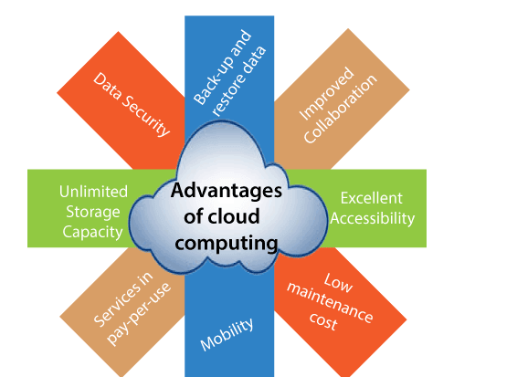
Advantages of Cloud Computing

Slide 8
Advantages of Cloud Computing
1) Back-up and restore data
Once the data is stored in the cloud, it is easier to get back-up and restore that data using the cloud.
2) Improved collaboration
Cloud applications improve collaboration by allowing groups of people to quickly and easily share information in the cloud via shared storage.
3) Excellent accessibility
Cloud allows us to quickly and easily access stored information anywhere, anytime in the whole world, using an internet connection. An internet cloud infrastructure increases organization productivity and efficiency by ensuring that our data is always accessible.
4) Low maintenance cost
Cloud computing reduces both hardware and software maintenance costs for organizations.

Slide 9
Advantages of Cloud Computing (cont…)
5) Mobility
Cloud computing allows us to easily access all cloud data via mobile.
6) services in the pay-per-use model
Cloud computing offers Application Programming Interfaces (APIs) to the users for access services on the cloud and pays the charges as per the usage of service.
7) Unlimited storage capacity
Cloud offers us a huge amount of storage capacity for storing our important data such as documents, images, audio, video, etc. in one place.
8) Data security
Data security is one of the biggest advantages of cloud computing. Cloud offers many advanced features related to security and ensures that data is securely stored and handled.

Slide 10
Disadvantages of Cloud Computing
1) Internet Connectivity
In cloud computing, all data (image, audio, video, etc.) is stored on the cloud, and we access these data through the cloud by using the internet connection. If you do not have good internet connectivity, you cannot access these data. However, we have no any other way to access data from the cloud.
2) Vendor lock-in
Vendor lock-in is the biggest disadvantage of cloud computing. Organizations may face problems when transferring their services from one vendor to another. As different vendors provide different platforms, that can cause difficulty moving from one cloud to another.
3) Limited Control
Cloud infrastructure is completely owned, managed, and monitored by the service provider, so the cloud users have less control over the function and execution of services within a cloud infrastructure.

Slide 11
Disadvantages of Cloud Computing (Cont…)
4) Security
Although cloud service providers implement the best security standards to store important information. But, before adopting cloud technology, you should be aware that you will be sending all your organization's sensitive information to a third party, i.e., a cloud computing service provider. While sending the data on the cloud, there may be a chance that your organization's information is hacked by Hackers.

Slide 12
History of Cloud Computing
Before emerging the cloud computing, there was Client/Server computing which is basically a centralized storage in which all the software applications, all the data and all the controls are resided on the server side.
If a single user wants to access specific data or run a program, he/she need to connect to the server and then gain appropriate access, and then he/she can do his/her business.
Then after, distributed computing came into picture, where all the computers are networked together and share their resources when needed.
At around in 1961, John MacCharty suggested in a speech at MIT that computing can be sold like a utility, just like a water or electricity.

Slide 13
History of Cloud Computing (Cont…)
In 1999, Salesforce.com started delivering of applications to users using a simple website. The applications were delivered to enterprises over the Internet, and this way the dream of computing sold as utility were true.
In 2002, Amazon started Amazon Web Services, providing services like storage, computation and even human intelligence. However, only starting with the launch of the Elastic Compute Cloud in 2006 a truly commercial service open to everybody existed.
In 2009, Google Apps also started to provide cloud computing enterprise applications.
In 2009, Microsoft launched Windows Azure, and companies like Oracle and HP have all joined the game. This proves that today, cloud computing has become mainstream.

Slide 14
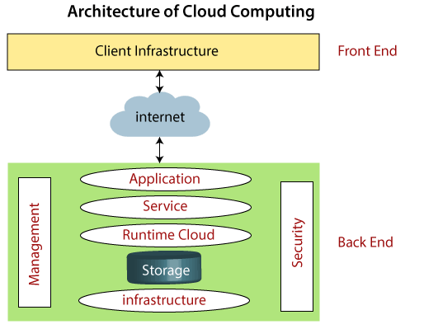
Cloud Computing Architecture
Cloud computing architecture is a combination of service-oriented architecture and event-driven architecture.
Cloud computing architecture is divided into the following two parts -
Front End
Back End

Slide 15
Cloud Computing Architecture
Front End
The front end is used by the client.
It contains client-side interfaces and applications that are required to access the cloud computing platforms.
The front end includes web clients (including Chrome, Firefox, internet explorer, etc.), thin & fat clients, tablets, and mobile devices.
Back End
The back end is used by the service provider.
It manages all the resources that are required to provide cloud computing services.
It includes a huge amount of data storage, security mechanism, virtual machines, deploying models, servers, traffic control mechanisms, etc.

Slide 16
Components of Cloud Computing Architecture
There are the following components of cloud computing architecture -
1. Client Infrastructure: Client Infrastructure is a Front end component. It provides GUI (Graphical User Interface) to interact with the cloud.
2. Application: The application may be any software or platform that a client wants to access.
3. Service: A Cloud Services manages which type of service you access according to the client’s requirement.
Cloud computing offers the following three type of services:
Infrastructure as a Service (IaaS)
Platform as a Service (PaaS)
Software as a Service (SaaS)

Slide 17
Components of Cloud Computing Architecture (Cont…)
Software as a Service (SaaS)
It is also known as cloud application services.
Mostly, SaaS applications run directly through the web browser means we do not require to download and install these applications.
Example: Google Apps, Salesforce Dropbox, Slack, Hubspot, Cisco WebEx.
Platform as a Service (PaaS)
It is also known as cloud platform services.
It is quite similar to SaaS, but the difference is that PaaS provides a platform for software creation, but using SaaS, we can access software over the internet without the need of any platform.
Example: Windows Azure, Force.com, Magento Commerce Cloud, OpenShift.

Slide 18
Components of Cloud Computing Architecture (Cont…)
Infrastructure as a Service (IaaS) I
It is also known as cloud infrastructure services.
It is responsible for managing applications data, middleware, and runtime environments.
Example: Amazon Web Services (AWS) EC2, Google Compute Engine (GCE), Cisco Metapod.

Slide 19
Components of Cloud Computing Architecture (Cont…)
4. Runtime Cloud
Runtime Cloud provides the execution and runtime environment to the virtual machines.
5. Storage
Storage is one of the most important components of cloud computing. It provides a huge amount of storage capacity in the cloud to store and manage data.
6. Infrastructure
It provides services on the host level, application level, and network level.
Cloud infrastructure includes hardware and software components such as servers, storage, network devices, virtualization software, and other storage resources that are needed to support the cloud computing model.

Slide 20
Components of Cloud Computing Architecture (Cont…)
7. Management
Management is used to manage components such as application, service, runtime cloud, storage, infrastructure, and other security issues in the backend and establish coordination between them.
8. Security
Security is an in-built back-end component of cloud computing. It implements a security mechanism in the back end.
9. Internet
The Internet is a medium through which the front end and back end can interact and communicate with each other.

Slide 21
Cloud Computing Technologies
A list of cloud computing technologies is given below:
Virtualization
Service Oriented Architecture (SOA)
Grid Computing
Utility Computing

Slide 22
Virtualization
Virtualization is the process of creating a virtual environment to run multiple applications and operating systems on the same server.
The virtual environment can be anything, such as a single instance or a combination of many operating systems, storage devices, network application servers, and other environments.
The concept of Virtualization in cloud computing increases the use of virtual machines.
A virtual machine is a software computer or software program that not only works as a physical computer but can also function as a physical machine and perform tasks such as running applications or programs as per the user's demand.

Slide 23
Types of Virtualization
Hardware virtualization
Server virtualization
Storage virtualization
Operating system virtualization
Data Virtualization

Slide 24
Service Oriented Architecture
Service-Oriented Architecture (SOA) allows organizations to access on-demand cloud-based computing solutions according to the change of business needs.
It can work without or with cloud computing.
The advantages of using SOA are that it is easy to maintain, platform-independent, and highly scalable.
Service Providers and Service consumers are the two major roles within SOA.
Applications of Service-Oriented Architecture
It is used in the healthcare industry.
It is used to create many mobile applications and games.
In the air force, SOA infrastructure is used to deploy situational awareness systems.

Slide 25
Grid Computing
Grid computing is also known as distributed computing.
It is a processor architecture that combines various different computing resources from multiple locations to achieve a common goal.
In grid computing, the grid is connected by parallel nodes to form a computer cluster. These computer clusters are in different sizes and can run on any operating system.
Grid computing contains the following three types of machines
Control Node: It is a group of servers that administrates the whole network.
Provider: It is a computer that contributes its resources to the network resource pool.
User: It is a computer that uses the resources on the network.
Mainly, grid computing is used in ATMs, back-end infrastructures, and marketing research.

Slide 26
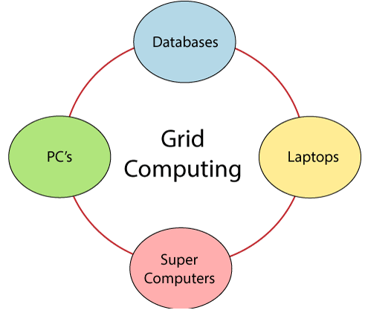
Grid Computing (Cont…)

Slide 27
Cloud Computing V/s Grid Computing
Cloud Computing | Grid Computing
Cloud computing uses a client-server architecture to deliver computing resources such as servers, storage, databases, and software over the cloud (Internet) with pay-as-you-go pricing. | Grid computing is also called as "distributed computing." It links multiple computing resources (PC's, workstations, servers, and storage elements) together and provides a mechanism to access them.
Cloud computing becomes a very popular option for organizations by providing various advantages, including cost-saving, increased productivity, efficiency, performance, data back-ups, disaster recovery, and security. | The main advantages of grid computing are that it increases user productivity by providing transparent access to resources, and work can be completed more quickly.
https://data-flair.training/blogs/grid-computing-vs-cloud-computing/

Slide 28
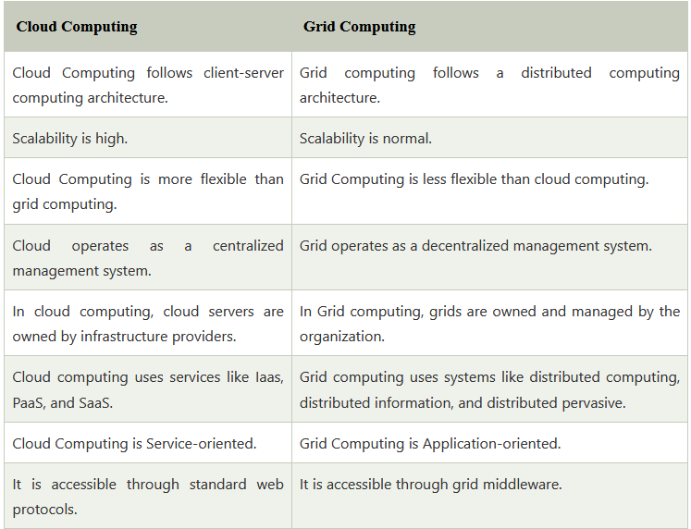
Cloud Computing V/s Grid Computing

Slide 29
Cloud Computing Working
Case Study:
Assume that you are an executive at a very big corporation. Your particular responsibilities include making sure that all of your employees have the right hardware and software they need to do their jobs.
To buy computers for everyone is not enough. You also have to purchase software as well as software licenses and then provide this software to your employees as they require.
Whenever you hire a new employee, you need to buy more software or make sure your current software license allows another user. It is so stressful that you have to spend lots of money.

Slide 30
Cloud Computing Working (Cont…)
Case Study:
But, there may be an alternative for executives like you. So, instead of installing a suite of software for each computer, you just need to load one application.
That application will allow the employees to log in to a Web-based service that hosts all the programs for the user that is required for his/her job.
Remote servers owned by another company that will run everything from e-mail to word processing to complex data analysis programs. It is called cloud computing, and it could change the entire computer industry.

Slide 31
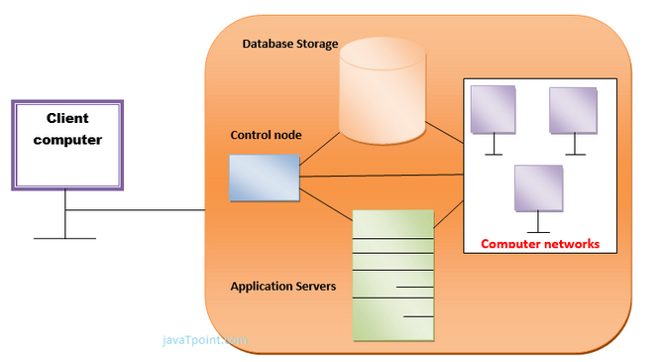
Cloud Computing Working (Cont…)

Slide 32
Cloud Computing Working (Cont…)
Case Study:
In a cloud computing system, there is a significant workload shift. Local computers have no longer to do all the heavy lifting when it comes to running applications.
But cloud computing can handle that heavy load easily and automatically.
Hardware and software demands on the user's side decrease.
The only thing the user's computer requires to be able to run is the cloud computing interface software of the system, which can be as simple as a Web browser and the cloud's network takes care of the rest.

Slide 33
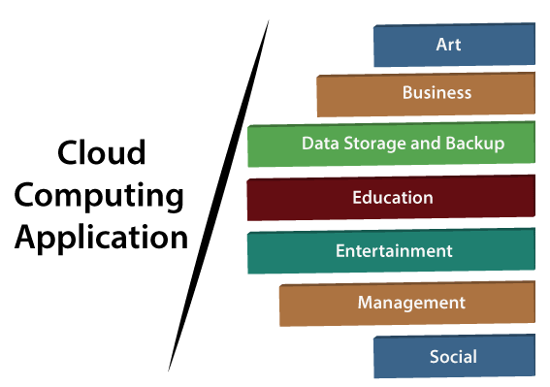
Cloud Computing Applications
Cloud Service Providers (CSPs) provide various applications in the field of art, business, data storage, and backup services, education, entertainment, management, social networking, etc.
The most widely used cloud computing applications are given below -

Slide 34
Cloud Computing Applications (Cont…)
1. Art Applications
Cloud computing offers various art applications for quickly and easily design attractive cards, booklets, and images. Some most commonly used cloud art applications are given below:
Moo: Moo is one of the best cloud art applications. It is used for designing and printing business cards, postcards, and mini cards.
Vistaprint: Vistaprint allows us to easily design various printed marketing products such as business cards, Postcards, Booklets, and wedding invitation cards.
Adobe Creative Cloud: Adobe creative cloud is made for designers, artists, filmmakers, and other creative professionals. It is a suite of apps that includes PhotoShop image editing programming, Illustrator, InDesign, TypeKit, Dreamweaver, XD, and Audition.

Slide 35
Cloud Computing Applications (Cont…)
2. Business Applications
Business applications are based on cloud service providers. Today, every organization requires a cloud business application to grow its business. It also ensures that business applications are 24*7 available to users.
There are the following business applications of cloud computing –
MailChimp: MailChimp is an email publishing platform that provides various options to design, send, and save templates for emails.
Salesforce: Salesforce platform provides tools for sales, service, marketing, e-commerce, and more. It also provides a cloud development platform.
Chatter: Chatter helps us to share important information about the organization in real-time.
Bitrix24: Bitrix24 is a collaboration platform that provides communication, management, and social collaboration tools.
Paypal: Paypal offers the simplest and easiest online payment mode using a secure internet account. Paypal accepts payment through debit cards, credit cards, and also from Paypal account holders.

Slide 36
Cloud Computing Applications (Cont…)
3. Data Storage and Backup Applications: Cloud computing allows us to store information (data, files, images, audio, and videos) in the cloud and access this information using an internet connection. As the cloud provider is responsible for providing security, so they offer various backup recovery applications for retrieving the lost data.
A list of data storage and backup applications in the cloud is given below -
Box.com: Box provides an online environment for secure content management, workflow, and collaboration. It allows us to store different files such as Excel, Word, PDF, and images on the cloud. The main advantage of using box is that it provides drag & drop service for files and easily integrates with Office 365, G Suite, Salesforce, and more than 1400 tools.
Mozy: Mozy provides powerful online backup solutions for our personal and business data. It schedules automatically back up for each day at a specific time.
Joukuu : Joukuu provides the simplest way to share and track cloud-based backup files. Many users use joukuu to search files, and folders, and collaborate on documents.
Google G Suite: Google G Suite is one of the best cloud storage and backup application. It includes Google Calendar, Docs, Forms, Google+, and Hangouts, as well as cloud storage and tools for managing cloud apps. The most popular app in the Google G Suite is Gmail.

Slide 37
Cloud Computing Applications (Cont…)
4. Education Applications
Cloud computing in the education sector becomes very popular.
It offers various online distance learning platforms and student information portals to the students.
The advantage of using cloud in the field of education is that it offers
strong virtual classroom environments,
Ease of accessibility,
secure data storage,
scalability,
greater reach for the students, and
minimal hardware requirements for the applications.

Slide 38
Cloud Computing Applications (Cont…)
4. Education Applications
There are the following education applications offered by the cloud:
i. Google Apps for Education: Google Apps for Education is the most widely used platform for free web-based email, calendar, documents, and collaborative study.
ii. Chromebooks for Education: Chromebook for Education is one of the most important Google projects. It is designed for the purpose that it enhances education innovation.
iii. Tablets with Google Play for Education: It allows educators to quickly implement the latest technology solutions into the classroom and make it available to their students.
iv. AWS in Education: AWS cloud provides an education-friendly environment to universities, community colleges, and schools.

Slide 39
Cloud Computing Applications (Cont…)
5. Entertainment Applications
Entertainment industries use a multi-cloud strategy to interact with the target audience. Cloud computing offers various entertainment applications such as online games and video conferencing.
i. Online games: Today, cloud gaming becomes one of the most important entertainment media. It offers various online games that run remotely from the cloud. The best cloud gaming services are Shaow, GeForce Now, Vortex, Project xCloud, and PlayStation Now.
ii. Video Conferencing Apps: Video conferencing apps provide a simple and instant connected experience. It allows us to communicate with our business partners, friends, and relatives using a cloud-based video conferencing. The benefits of using video conferencing are that it reduces cost, increases efficiency, and removes interoperability.

Slide 40
Cloud Computing Applications (Cont…)
6. Management Applications
Cloud computing offers various cloud management tools which help admins to manage all types of cloud activities, such as resource deployment, data integration, and disaster recovery. These management tools also provide administrative control over the platforms, applications, and infrastructure.
Some important management applications are -
i. Toggl: Toggl helps users to tracthe k allocated time period for a particular project.
ii. Evernote: Evernote allows you to sync and save your recorded notes, typed notes, and other notes in one convenient place. It is available for both free as well as a paid version.
It uses platforms like Windows, macOS, Android, iOS, Browser, and Unix.
iii. Outright: Outright is used by management users for the purpose of accounts. It helps to track income, expenses, profits, and losses in real-time environment.
iv. GoToMeeting: GoToMeeting provides Video Conferencing and online meeting apps, which allows you to start a meeting with your business partners from anytime, anywhere using mobile phones or tablets. Using the GoToMeeting app, you can perform the tasks related to the management such as join meetings in seconds, view presentations on the shared screen, get alerts for upcoming meetings, etc.

Slide 41
Cloud Computing Applications (Cont…)
7. Social Applications
Social cloud applications allow a large number of users to connect with each other using social networking applications such as Facebook, Twitter, Linkedln, etc.
There are the following cloud-based social applications -
i. Facebook: Facebook is a social networking website that allows active users to share files, photos, videos, statuses, and more to their friends, relatives, and business partners using the cloud storage system. On Facebook, we will always get notifications when our friends like and comment on the posts.
ii. Twitter: Twitter is a social networking site. It is a microblogging system. It allows users to follow high-profile celebrities, friends, and relatives, and receive news. It sends and receives short posts called tweets.
iii. Yammer: Yammer is the best team collaboration tool that allows a team of employees to chat, and share images, documents, and videos.
iv. LinkedIn: LinkedIn is a social network for students, freshers, and professionals.

